Slide 1

Unlocking Insights: A Data Science Journey
Welcome to our exploration of advanced data analytics. This presentation outlines our comprehensive approach to transforming raw data into actionable insights, providing a deep dive into our methodologies and key findings.

Slide 2
Agenda
Our Data Science Roadmap
01
02
03
Executive Summary
Methodology Deep Dive
Key Findings & Visualizations
High-level overview of our project goals and key achievements.
Detailed look at our data handling, analysis, and modeling techniques.
Showcasing the results from our Exploratory Data Analysis, SQL queries, and interactive dashboards.
04
05
Predictive Modeling
Conclusion & Next Steps
Unveiling the outcomes of our classification analysis and its implications.
Summarizing our journey and outlining future directions.

Slide 3

Executive Summary: Bridging Data to Decisions
This project successfully leveraged a multi-faceted data science approach to extract meaningful insights from complex datasets. We integrated advanced data wrangling, exploratory analytics, and predictive modeling to uncover hidden patterns and inform strategic decisions.
Streamlined data pipelines for efficiency.
Developed intuitive interactive dashboards for stakeholder engagement.
Achieved high accuracy in predictive classification tasks.

Slide 4
Our Methodological Backbone
Data Collection & Wrangling
EDA & Interactive Visual Analytics
Predictive Analysis
We employed robust methods for collecting diverse data sources, followed by rigorous cleaning, transformation, and normalization. This ensures data quality and consistency, forming a solid foundation for analysis.
Leveraging cleansed and understood data, we built and validated predictive models. Our focus was on classification tasks, employing state-of-the-art algorithms to forecast outcomes with high precision and recall.
Our Exploratory Data Analysis (EDA) focused on understanding data distributions, relationships, and anomalies. We used interactive visualization tools to allow dynamic exploration and rapid insight generation, fostering collaborative discovery.
Automated data ingestion from various APIs and databases.
Utilized ensemble methods for enhanced prediction accuracy.
Handled missing values and outliers with advanced imputation techniques.
Identified key trends and correlations through statistical tests.
Implemented cross-validation to ensure model generalization.
Developed custom dashboards for real-time data exploration.
Interpreted model outputs to explain prediction drivers.
Feature engineering to create impactful variables for modeling.
Enabled drill-down capabilities for granular insights.

Slide 5
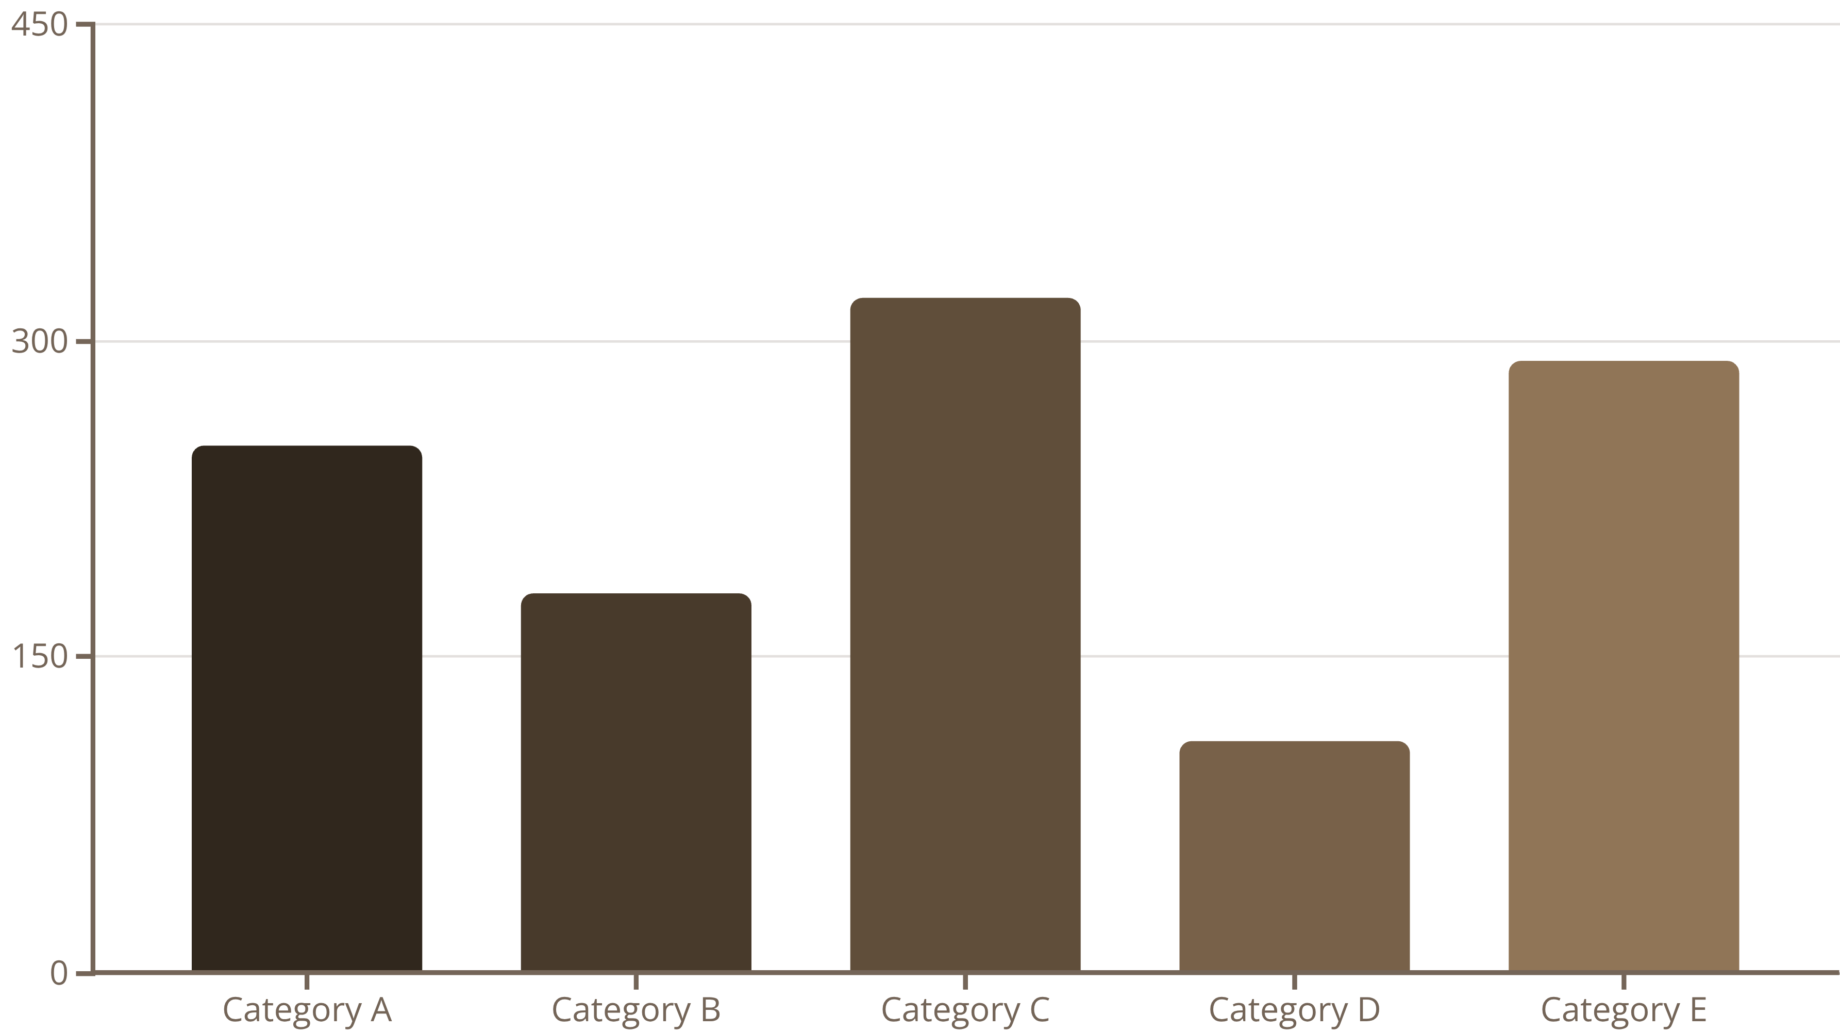
EDA Results: Unveiling Data Patterns
Our Exploratory Data Analysis (EDA) using Matplotlib and Plotly revealed compelling insights into the dataset's distribution. As seen in the chart, Category C consistently exhibits the highest frequency, suggesting it's a dominant feature within our data. This distribution will significantly influence subsequent modeling decisions.

Slide 6

SQL Results: Precision Querying for Key Findings
Through targeted SQL queries, we extracted critical metrics and identified specific data subsets crucial for our analysis. For instance, a query on customer transaction data highlighted that customers in the "Premium" tier showed a 25% higher average purchase value compared to other segments.
"Leveraging SQL allowed us to precisely isolate and understand specific data relationships that would have been obscured in aggregated views."

Slide 7
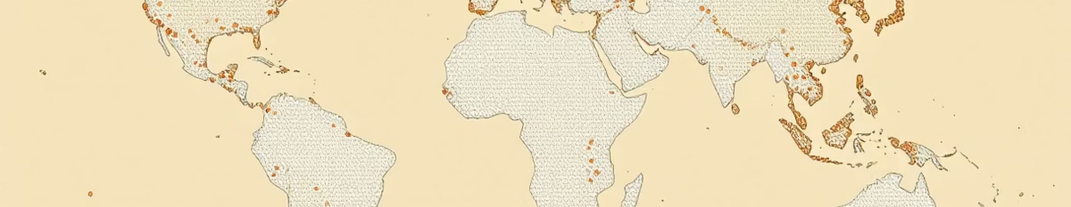
Geospatial Insights with Folium
Folium proved invaluable for visualizing the geographical distribution of our data. We identified significant clusters of activity in urban centers on the East Coast and specific industrial zones in the Midwest. This spatial understanding can inform localized strategies and resource allocation, optimizing our outreach efforts.

Slide 8

Interactive Dashboards with Plotly Dash
Our Plotly Dash dashboard provides an intuitive, interactive interface for stakeholders to explore the data independently. Users can filter by time period, demographic, and product type, gaining real-time insights into performance metrics. This empowers data-driven decision-making across departments.
Key features include:
Dynamic filtering and drill-down capabilities.
Real-time updates from underlying data sources.
Exportable reports for further analysis.

Slide 9


Predictive Analysis: Classifying Future Outcomes
Model Selection
Performance
We deployed a RandomForest Classifier for its robustness and interpretability in predicting customer churn.
Achieved an accuracy of 88% and an F1-score of 0.85 on unseen data.
Key Features
Implications
Top predictors for churn included contract duration and customer service interactions.
Enables proactive intervention for at-risk customers, potentially reducing churn by 15%.

Slide 10
Conclusion & Next Steps: Charting the Future
Key Takeaways
Recommendations
Comprehensive data wrangling ensures high data quality.
Integrate real-time data streams into the dashboard.
Visual analytics drive intuitive insights.
Expand predictive modeling to include demand forecasting.
Predictive models provide actionable foresight.
Automate report generation for routine monitoring.
Thank you for your time. We welcome your questions and further collaboration.

